Slide 1

Methodist College of Engineering & Technology
Project Team: 961CS-A05
Domain: Machine Learning
Project Title: Voice Based Email System
Guide Name: Ms. Unnati K
S. No. | Roll no. | Student Name | Role in Team
1 | 160717733008 | T SAI CHARAN REDDY | Team Leader
2 | 160717733004 | N GAGAN KUMAR | Team Member
3 | 160717733032 | A SREEKAR | Team Member
Under the guidance of Project Coordinator
Ms. Unnati K Mr. M. Krishnamurthy
Assistant Professor Assistant Professor
Department of CSE Department of CSE

Slide 2
OUTLINE
PART 1 :
Introduction(Motivation, Abstract)
Literature Survey
Methodology
Design And Implementation
Result & Conclusions(Summary)
PART 2 :
UML Diagram
Project Execution
PART 3 :
Quaternaries & Suggestions

Slide 3
1.1MOTIVATION
WHY “VOICE BASED EMAIL SYSTEM FOR VISULLY IMPAIRED ” ?
WHAT IS THE MAIN PROBLEM ?
LIMITATIONS ?
SOLUTUION ?

Slide 4
1.2 ABSTRACT
As the technology is enhancing, people are coming closer to digital life and digital communication. In this new advanced era there are many ways to communicate with others through internet in this new advanced era. E-mail is one of the technologies that enables user to contact with others by sending mails and also helps in business world communication. There are people who cannot use these technologies because either they are illiterate or do not have ability to view the screen. So, to make this technology closer to visually challenged people we proposed a Voice Based E-mail System. This architecture will help visually challenged people to access e-mail. This system provides them the facility to communication and make them much stronger and independent.

Slide 5
1.3 INTRODUCTION
We have seen that the introduction of Internet has revolutionized many fields. Communication is one of the main fields which is changed by Internet.
E-mails are the most dependable way of communication over Internet, for sending and receiving some important information. But there is a certain norm for humans to access the Internet and the norm is we must be able to see.
But there are also differently abled people in our society who are not gifted with what we have. There are some visually impaired people who can’t see the computer screen or keyboard.

Slide 6
2. LITERATURE SURVEY

Slide 7
2.1 KEY FINDINGS
SNO. | AUTHORS | PAPER | TITLE YEAR | DESCRIPTION
1. | Jagtap Nilesh, Pawan Alai | Voice Based System in Desktop for Blind People | 2014 | This paper describes the voice mail architecture used by blind people to access E-mail and multimedia functions of operating system easily and efficiently. This architecture will also reduce cognitive load taken by blind to remember and type characters using keyboard. It also helps handicapped and illiterate people.
2. | G. Anusha , V. Jeevitha | An Interactive Email for Visually Impaired | 2014 | This paper explains the design and implementation of an interactive system for visually challenged people. Web accessibility stands as the inclusive practice of creating web based applications that can be used by people of all kind. The very basic and important need for using the internet is accessing emails. Micro systematic applied research has been done on how a visually challenged user can have an access to his emails and this paper completely concentrates in filling few gaps in doing that.

Slide 8
3. | Ummuhanysifa U.,Nizar Banu P K | Voice Based Search Engine and Web page Reader | 2015 | This paper aims to develop a search engine which supports Man-Machine interaction purely in the form of voice. A novel Voice based Search Engine and Web-page Reader which allows the users to command and control the web browser through their voice, is introduced. The existing Search Engines get request from the user in the form of text and respond by retrieving the relevant documents from the server and displays in the form of text.

Slide 9
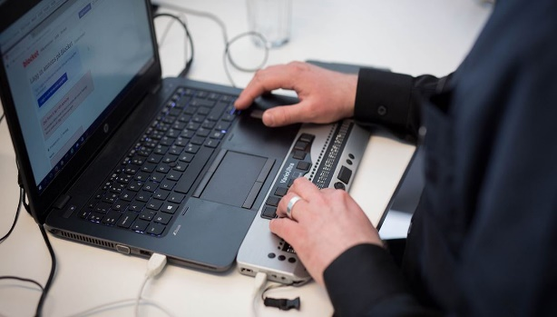
Existing System
Composing, reading and sending mail is a challenge to visually impaired as they can’t type through keyboard.
The way by which a visually challenged person can send an E-mail is, they have to speak the entire content of the mail to another person (not visually challenged) and then second person will compose the mail and send on the behalf of the visually challenged person. But this is not a right way to deal with the problem.
Figure 1 screen Reader

Slide 10
Drawbacks
It becomes difficult for blind people to access E-Mail since the screen reader is containing noisy audio interface.
Automatic Speech recognizer performance degrades if it contains noisy environment.
One of the main drawbacks is that both automatic speech recognizer and text to speech are language dependent.
Tools and technologies for blind people do not exist in mobile phones.
There is a use of a keyboard where blind people have to recognize the character which is very difficult for blind people.

Slide 11

Proposed System
This application provide a voice based mailing service where they could read and send mail on their own. Here, the users have to use certain keywords which will perform certain actions for e.g. Read, Send, Compose Mail etc.
One of the major advantages of this system is that user won’t require to use the keyboard.
Figure 2 visually impaired giving voice commands

Slide 12
Advantages
This system makes the disabled people feel like a normal user.
They can be able to do all their tasks simply by their voice.
Elimination of Screen Readers.
No need to memorize keyboard shortcuts.
Voice response is interactive and clear.
Limitations
This application will not work if the user is unable to speak.
Pronunciation should be accurate.
System should be connected with microphone.
Security could be an issue.

Slide 13
Objective
The application will be a python-based application. For visually challenged persons we use IVR- Interactive voice response.
Everyone can control their mail accounts using their voice and can be able to read, send, and perform all the other useful tasks.
This project aims to help the visually impaired people to be a part of growing digital India by using internet and also aims to make life of such people quite easy.

Slide 14
3. PROPOSED SYSTEM

Slide 15
3.1 PROJECT DESCRIPTION
Project Type
This is an experimental research project which first, analyzes and second designs and finally evaluates user to access email through voice commands for visually impaired people without any help.
Project Aim
The project first investigated existing email systems, screen reader‘s, and taking help from friends.
The next step was to build a voice based email system to easily implement and run various experiments on system through voice.

Slide 16
3.2 PROJECT MODULES
Voice Based Email:
The following operations can be performed in the application are :
Voice Based email
Compose mail
Checking Inbox
Smart Computer
Accessing Drives
Opening Applications
Exit

Slide 17
All the mentioned operations can be done on computer and email sequentially
It can make user to do operation on computer(opening drives) and email depending on other for visually impaired people by giving voice commands.

Slide 18
4. DESIGN

Slide 19
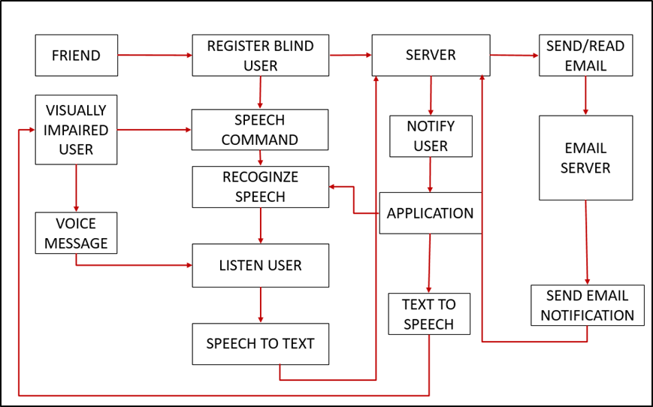
4.1 SYSTEM ARCHITECTURE
Figure 3 System Architecture for Voice based email system

Slide 20
4.2 UML DIAGRAM

Slide 21
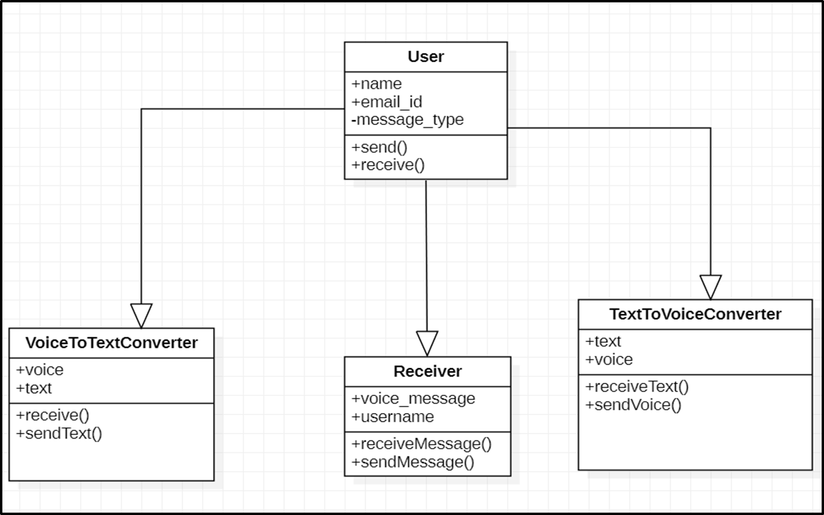
4.2.1 CLASS DIAGRAM
Figure 4 Class Diagram for Voice based email system

Slide 22
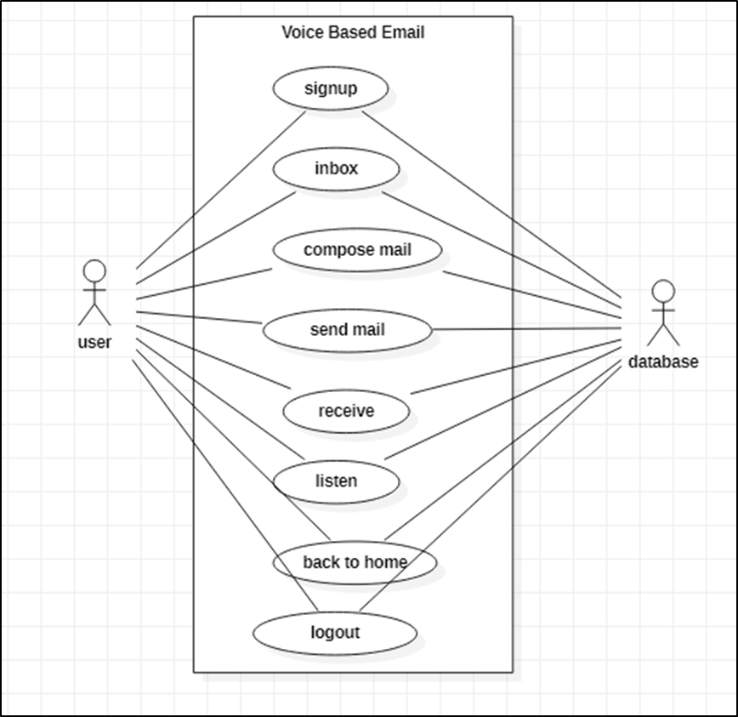
4.2.2 USE CASE DIAGRAM
Figure 5 Use Case Diagram for Voice based email system

Slide 23
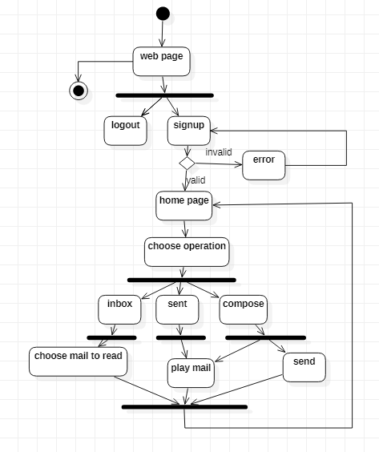
4.2.3 ACTIVITY DIAGRAM
Figure 6 Activity Diagram for Voice based email system

Slide 24
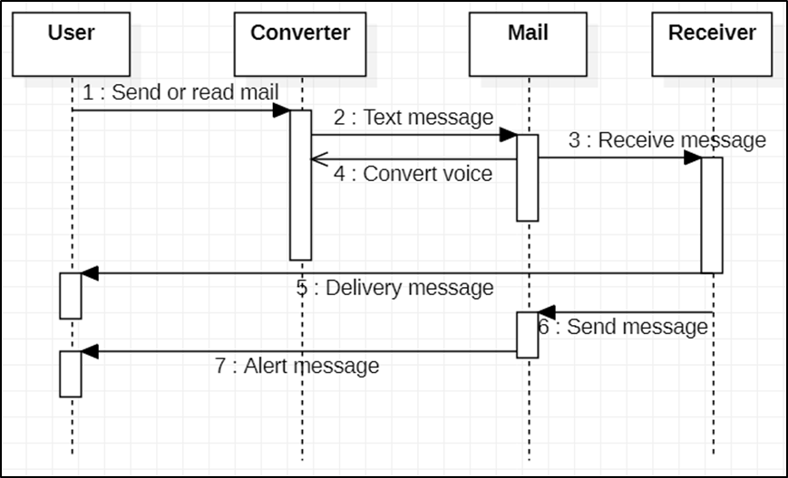
4.2.4 SEQUENCE DIAGRAM
Figure 7 Sequence Diagram for Voice based email system

Slide 25
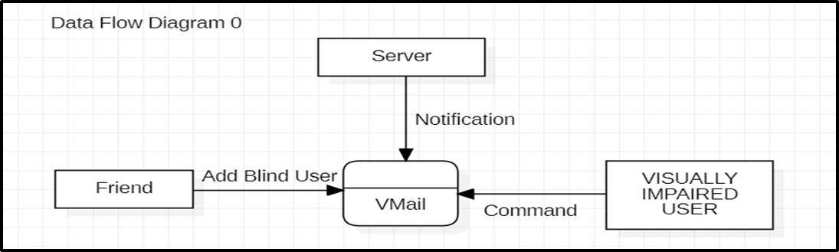
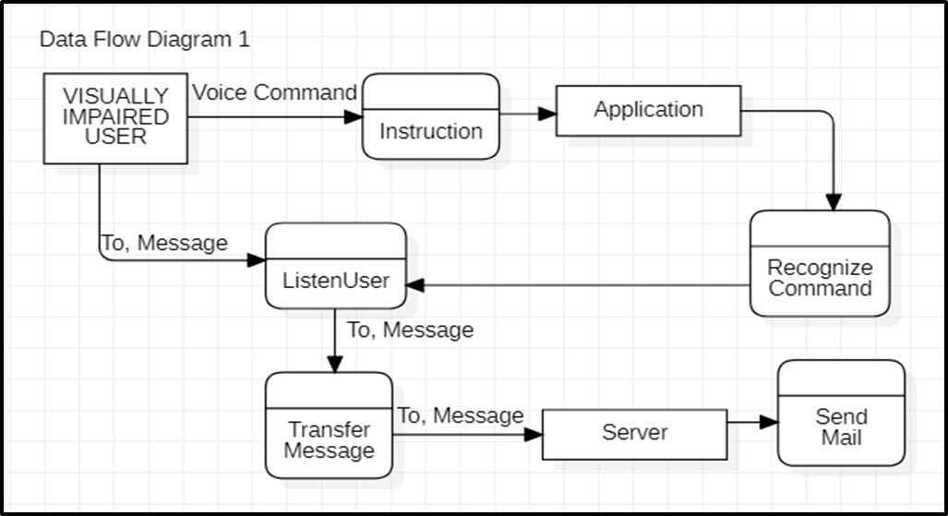
4.2.5 DATA FLOW DIAGRAM
Figure 4 Data flow Diagram 0 for Voice based email system
Figure 8 Data Flow Diagram 1 for Voice based email system

Slide 26
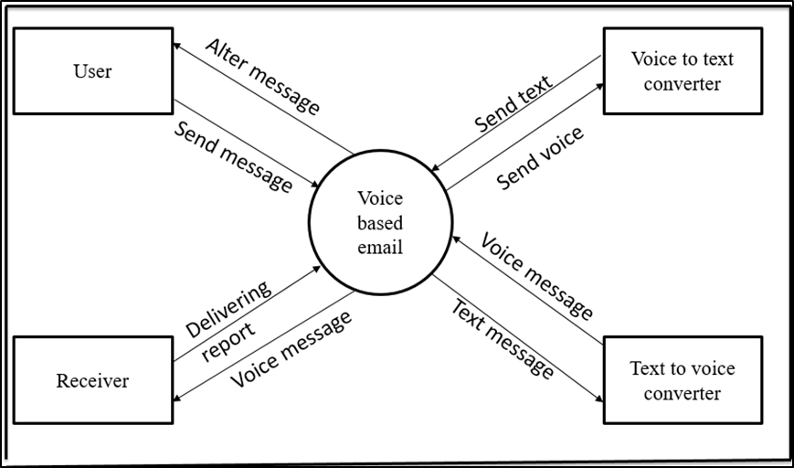
4.2.6 STATE CHART DIAGRAM
Figure 9 State Chart Diagram for Voice based email system

Slide 27
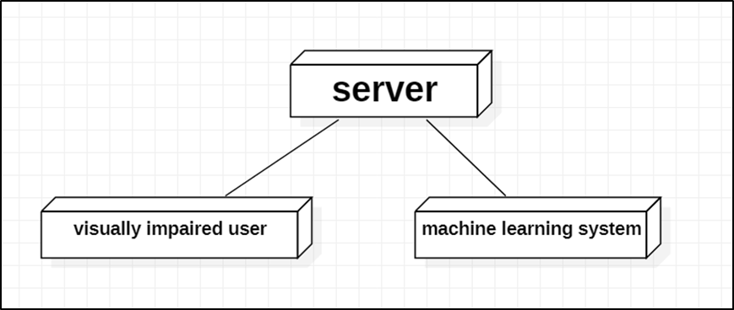
4.2.7 DEPLOYMENT DIAGRAM
Figure 10 Deployment Diagram for Voice based email system

Slide 28
5. IMPLEMENTATION

Slide 29
5.1 IMPLANTATION ALGORITHM
For voice based email system, we used speech recognition, pyttsx3, gTTS (packages) which is open source and free to use.
For connecting with Gmail server, we used imaplib, email packages.
All the operations on mails are done with the help of commands which are defined in the application.

Slide 30
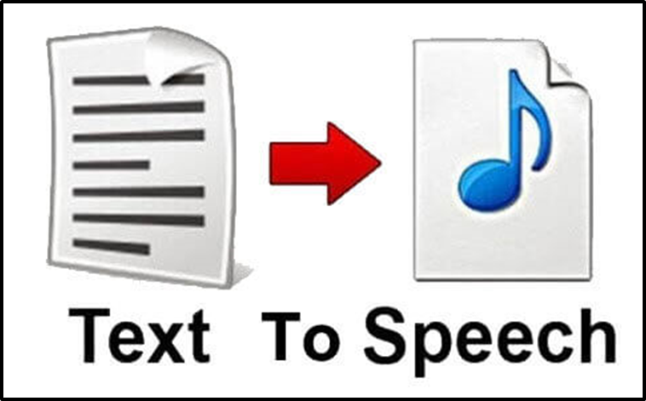
Text to Speech:
It converts normal text messages into speech format. A normal text can be heard through audio file. The input is a plain text and the output is in audio format which can only be heard. Each word can be heard through sound and the blind person can successfully be able to read the whole message using this API.
Figure 11 Text to Speech

Slide 31
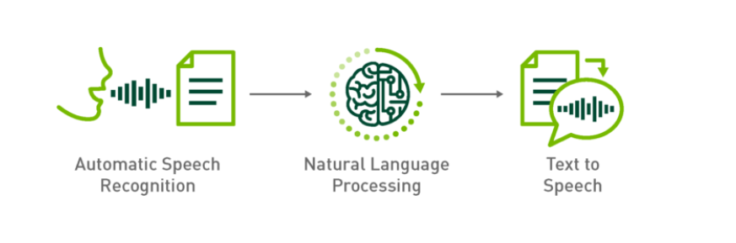
Speech Recognition:
It is used for individuals to perform actions through voice instead of using keyboard. This software takes input through voice and saves in mp3 format. After saving, it performs particular task and delete after the function is over. The user dictates the messages and the system accepts the message in voice format.
Figure 12 Speech Recognition

Slide 32
Speech Recognition:
It is used for individuals to perform actions through voice instead of using keyboard. This software takes input through voice and saves in mp3 format. After saving, it performs particular task and delete after the function is over. The user dictates the messages and the system accepts the message in voice format.
Figure 13 Speech Recognition

Slide 33
IMAP:
Internet message access protocol is used to fetch mails from Gmail so that the receiver can read the messages easily. The received messages are in the Gmail itself IMAP helps the user to connect to Gmail.
SMTP:
Simple mail transfer protocol helps to connect to Gmail. It helps in composing mails. It also acts as a connection to Gmail which helps in send of mails.

Slide 34
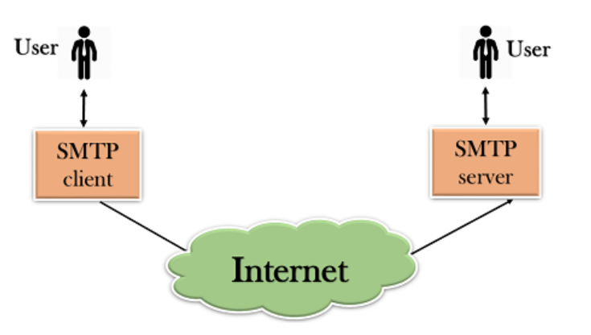
Figure 14 SMTP client - server

Slide 35
6. RESULT AND DISSCUSSIONS

Slide 36
6.1 TEST CASE Test Case 1
Test case 1: Verifying the Voice Based Email |  | Priority (H, L): High
Test Objective: To verify Voice Based Email
Test Description: Voice Operations like Composing mails Reading unseen mails(Inbox)
Requirements Verified: Yes
Test Environment: Windows 7 system and newer , 4GB RAM, i3 processor.
Actions | Expected Results
Doing operation with Voice commands | Outputs of all voice commands
Pass: Yes Conditions pass: Yes Fail: No
Problems / Issues: NIL
Notes: Successfully Executed

Slide 37
Test Case 2
Test case 2: Smart Computer |  | Priority (H, L): High
Test Objective: To verify Smart Computer
Test Description: Voice Operations like Opening drives(C-drive , D-drive ) Opening applications(Facebook , chrome)
Requirements Verified: Yes
Test Environment: Windows 7 system and newer , 4GB RAM, i3 processor.
Actions | Expected Results
Doing operation with Voice commands | Outputs of all voice commands
Pass: Yes Conditions pass: Yes Fail: No
Problems / Issues: NIL
Notes: Successfully Executed

Slide 38
6.2 OBSERVATION AND RECORD
We had observed all the operation and voice commands are running successfully with some limitations.
This application will not work if the user is unable to speak .
Pronunciation should be accurate.
System should be connected with microphone.
The project was successfully implemented and executed.

Slide 39
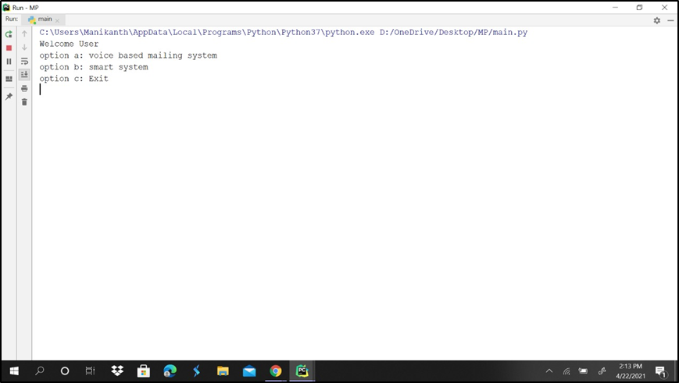
6.3 SCREENSHOTS
Screenshot of menu page
Figure 15 Menu page

Slide 40
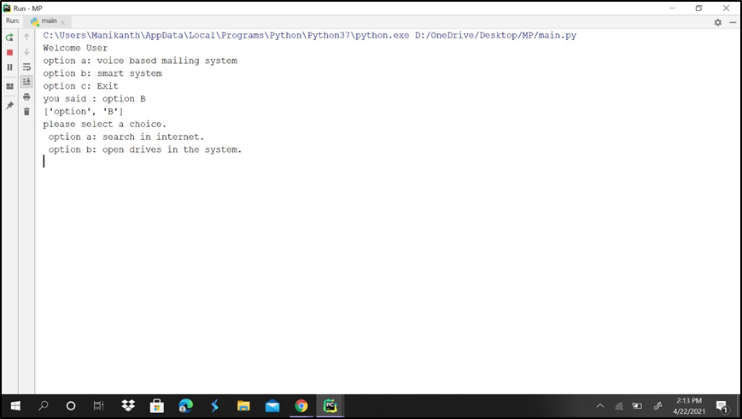
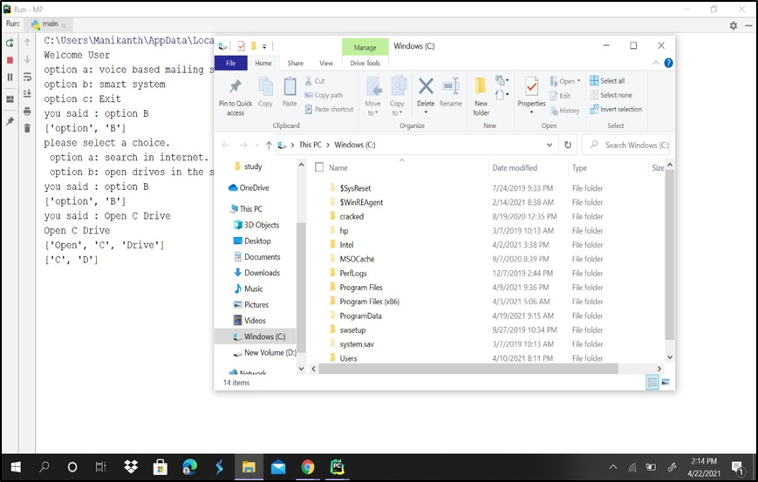
Screenshot of menu page for smart system
Screenshot of opening drives system
Figure 16 Menu page for smart system
Figure 17 opening drives

Slide 41
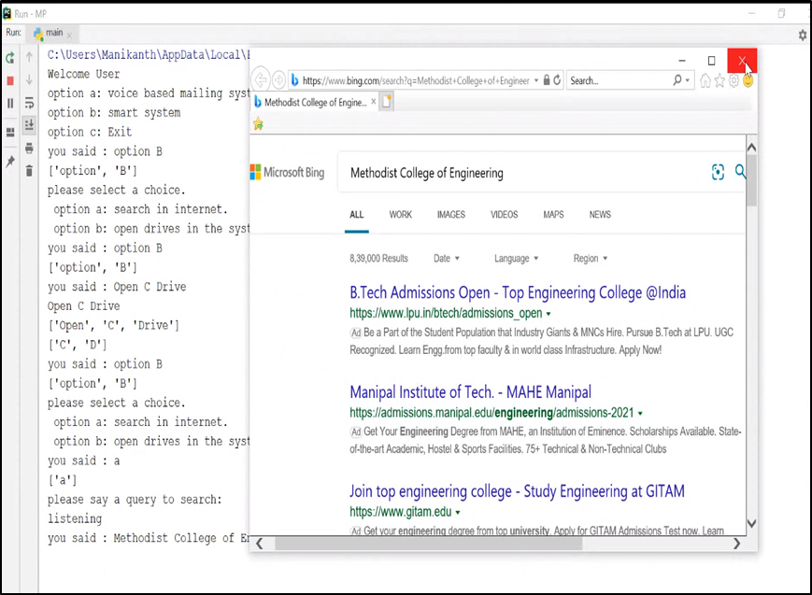
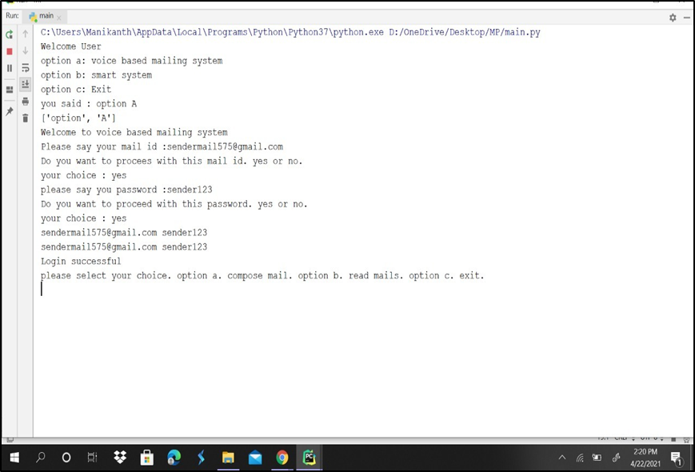
Screenshot of search in internet
Screenshot of menu page for voice based email system
Figure 18 Search in internet
Figure 19 menu page for voice based email system

Slide 42
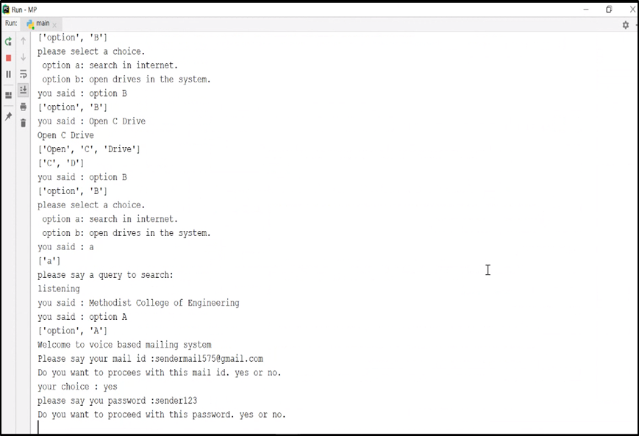
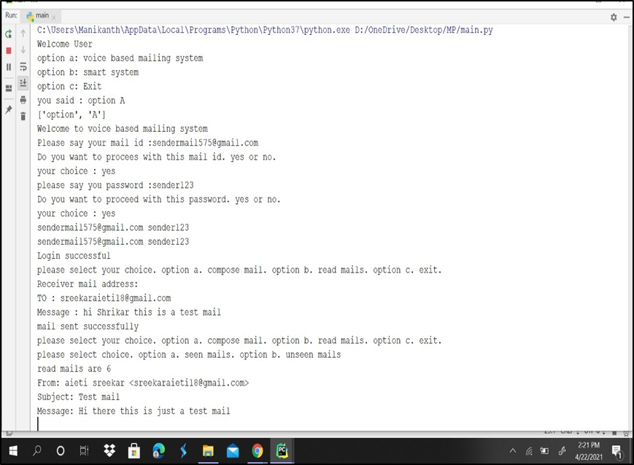
Screenshot of login to Gmail
Screenshot of sending mail
Figure 20 login to Gmail
Figure 21 sending mail

Slide 43
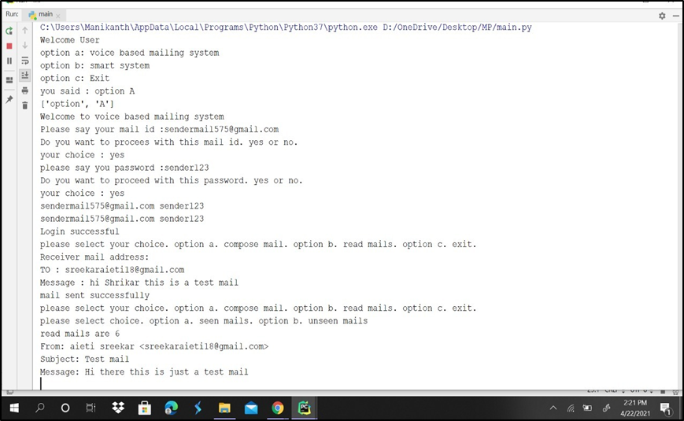
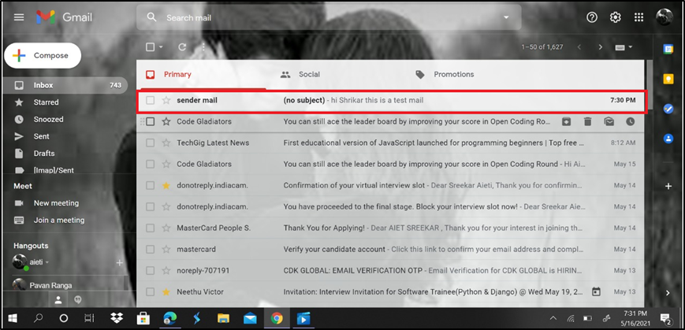
Screenshot of read mail
Screenshot of received mail
Figure 22 read mail
Figure 23 received mail

Slide 44
7. CONCLUSION AND FUTURE SCOPE

Slide 45
7.1 CONCLUSIONS
We have proposed an application which will help the visually impaired people to access the email services easily and efficiently.
This system will help in overcoming certain issues that the visually impaired people had to face earlier in using email systems.
Also we have completely eliminated the concept of using keyboard shortcuts and also the use of screen readers which may help in reducing the stress load of remembering the location of the keys on the keyboard. And user can use this system efficiently.

Slide 46
7.2 FUTURE SCOPE
Voice could be extended to image attachments and other options such as indentation, fonts, file attachment, downloading the file etc., that are available as in normal E-Mail.
Advanced features like accessing any particular file on a computer with the help of voice commands can be added to the application.

Slide 47
REFERENCES
• Ummuhanysifa U.,Nizar Banu P K , “Voice Based Search Engine and Web page Reader”. In International Journal of Computational Engineering Research (IJCER). Pages 1-5.
• G. Shoba, G. Anusha, V. Jeevitha, R. Shanmathi. “AN Interactive Email for Visually Impaired”. In International Journal of Advanced Research in Computer and Communication Engineering (IJARCCE), 2014 on Pages 5089-5092.
• Jagtap Nilesh, Pawan Alai, Chavhan Swapnil and Bendre M.R.. “Voice Based System in Desktop and Mobile Devices for Blind People”. In International Journal of Emerging Technology and Advanced Engineering (IJETAE), 2014 on Pages 404-407 (Volume 4, issue 2).

Slide 48
ACKNOLEDGEMENT
Mrs. Unnati K Mam (Project Guide)
Mr. M. Krishnamurthy(Project Coordinator)
Mrs. P Lavanya Mam (CSE Dept. HOD)
All Faculty Members of Panel 3

Slide 49
Q&A SESSION

